Slide 1
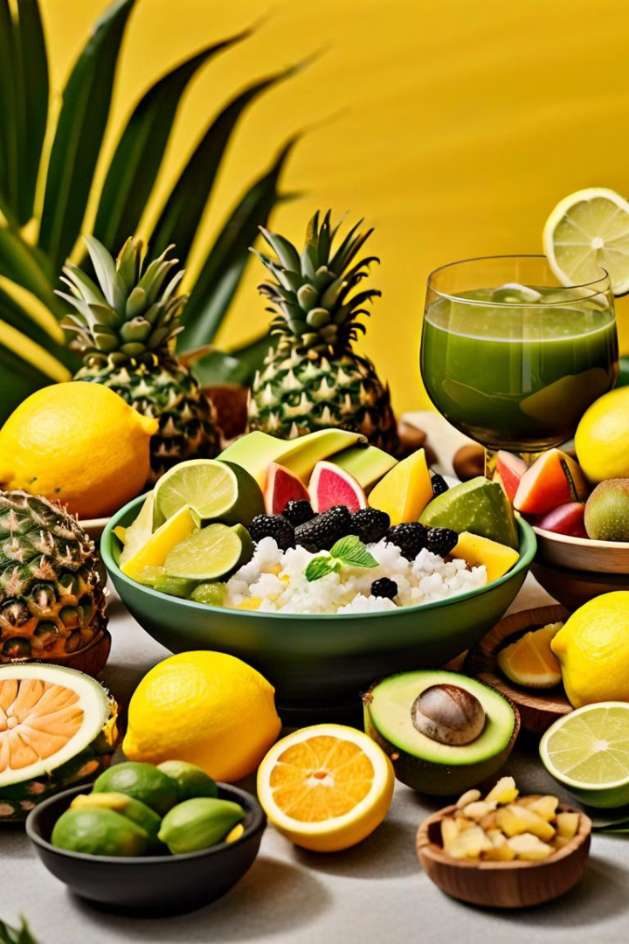


Introduction to Brazilian Cuisine
Brazilian cuisine is a rich tapestry of diverse culinary traditions, blending indigenous, European, and African influences. From the iconic dishes to the abundant local ingredients, it offers a flavorful and captivating gastronomic experience.
by gabriel thiessen

Slide 2
Diverse Culinary Traditions
Indigenous Influences
Portuguese and European Legacies
African Heritage
The significant African diaspora in Brazil has left an indelible mark on the country's cuisine, with dishes like feijoada and acarajé becoming beloved national favorites.
The cuisine of Brazil's indigenous peoples, such as the Amazonian tribes, has contributed staple ingredients like cassava, açaí, and a variety of tropical fruits.
The colonial era brought Portuguese, Italian, and other European culinary traditions, introducing techniques and ingredients like olive oil, breads, and dairy products.

Slide 3
Iconic Brazilian Dishes
1
Feijoada
2
Churrasco
A hearty stew of black beans, pork, and a variety of smoked and cured meats, often served with rice, collard greens, and orange slices.
The renowned Brazilian barbecue, featuring a variety of grilled meats, sausages, and vegetables, accompanied by chimichurri sauce and sides like farofa.
3
Moqueca
4
Brigadeiro
A flavorful seafood stew made with fish, shrimp, coconut milk, and a blend of spices and herbs, often served with rice and pirão.
A decadent chocolate truffle-like confection, made with condensed milk, cocoa powder, and butter, a beloved Brazilian dessert.

Slide 4
Ingredients and Flavors
Tropical Fruits
Spices and Herbs
Brazil is home to a diverse array of tropical fruits, such as passion fruit, guava, acai, and cashew apples, which add vibrant flavors and nutrients to Brazilian cuisine.
The extensive use of spices like cumin, coriander, and malagueta peppers, as well as fresh herbs like cilantro and parsley, infuses Brazilian dishes with bold, aromatic flavors.
Staple Ingredients
Regional Variations
Cassava (manioc), rice, beans, and a variety of seafood and meats are foundational ingredients that form the backbone of many Brazilian culinary traditions.
Each region of Brazil has its own unique culinary specialties, reflecting the diversity of the country's landscapes, cultures, and local produce.

